Slide 1

Recruitment System Chat Bot
RecruitFlow AI
AI-Powered Multi-Agent Recruitment Assistant
Built with LangGraph · Intelligent. Automated. Scalable.
Team: Amathul Lubna · Anirudh Upadhyay ·Devineni Adhyumna Chowdhary · Mamidipally hansika
Team Name: Code Winners
College: Vardhaman College of Engineering
Speaker Notes: Welcome the audience and introduce the team. Set the stage: traditional hiring is broken, and AI is the answer. Transition to the problem statement on the next slide.

Slide 2
THE CHALLENGE
Hiring Is Broken — Here's Why
Recruiters spend 23 hours per hire on screening alone. Poor matching costs companies up to 30% of first-year earnings. The process is slow, expensive, and deeply inefficient.
⏱ Manual Screening
🎯 Poor Matching
Hours lost reviewing hundreds of unqualified resumes by hand
Candidates selected on keywords, not genuine fit or potential
💸 Salary Blindness
📋 Generic Interviews
No real-time market data to guide fair, competitive offers
One-size-fits-all questions that fail to assess true capability
Speaker Notes: Emphasize the statistics — 23 hours per hire and 30% cost of poor matches are powerful numbers. Ask the audience if they've experienced slow hiring. Transition by saying "What if AI could fix all of this?"

Slide 3
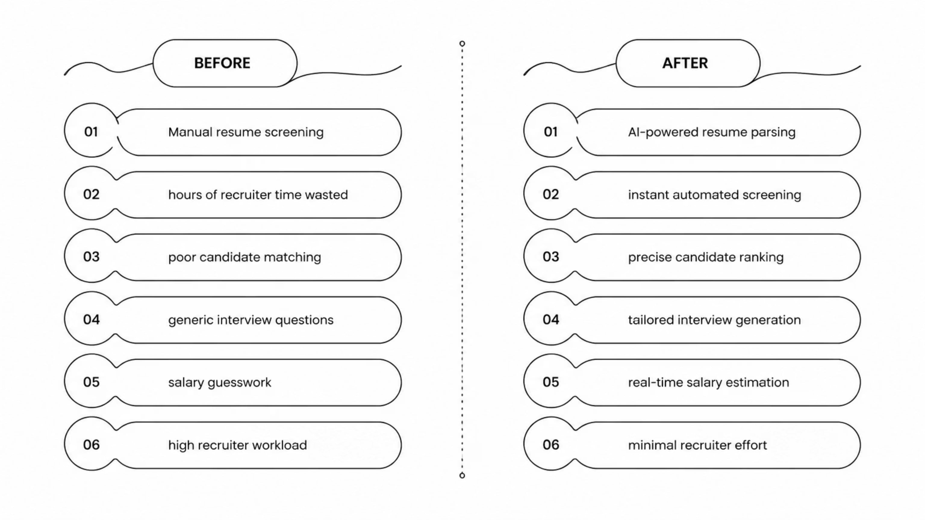
OUR SOLUTION
Introducing RecruitFlow AI
RecruitFlow AI is an intelligent, multi-agent recruitment assistant powered by LangGraph. It automates the entire hiring pipeline — from job description parsing to final candidate shortlisting — through a conversational, human-in-the-loop interface that keeps recruiters in control.
Before RecruitFlow AI
After RecruitFlow AI
Manual resume screening takes hours
Poor candidate-to-role matching
Generic, non-targeted interviews
Salary decisions made on guesswork
AI parses and screens in seconds
Precise, skill-based candidate ranking
Tailored interview questions per role
Real-time market salary estimation
Speaker Notes: Walk through the before/after comparison. Highlight how RecruitFlow doesn't just speed things up — it makes hiring smarter. Emphasize the human-in-the-loop design: AI assists, humans decide.

Slide 4
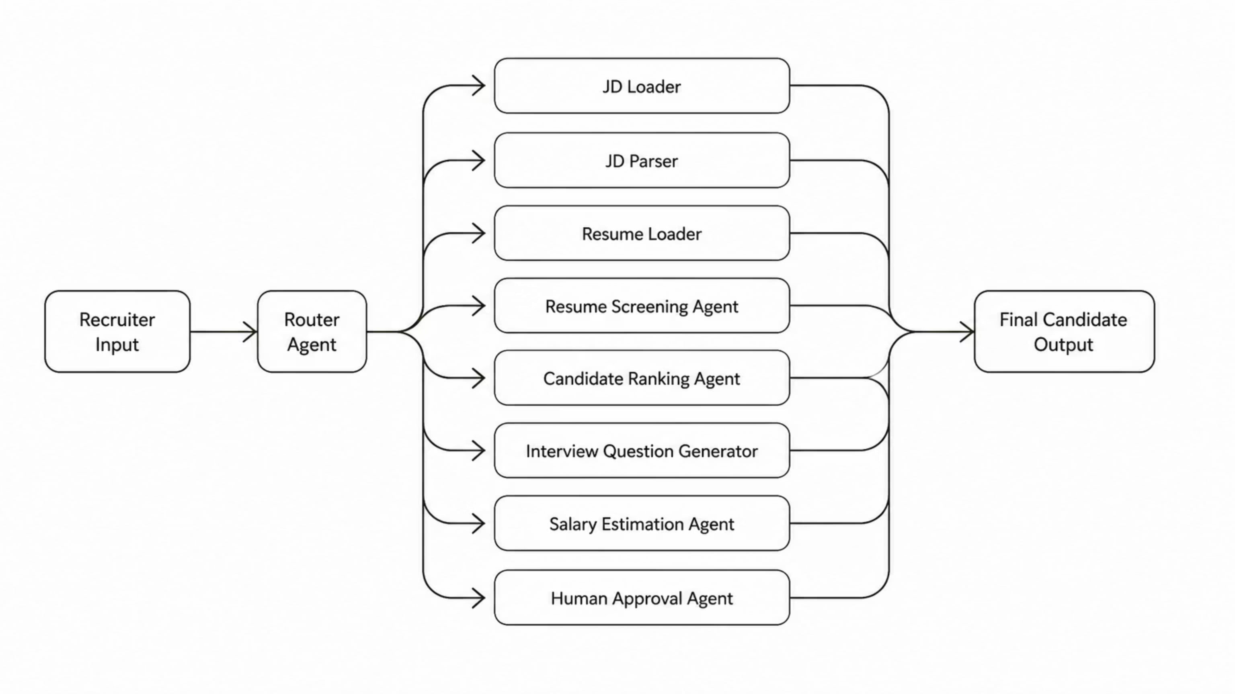
ARCHITECTURE
LangGraph Multi-Agent Architecture
RecruitFlow AI is built on a modular, graph-based agent architecture using LangGraph. Each agent operates as an independent AI component, orchestrated through a central router that manages state, memory, and handoffs — enabling complex, multi-step hiring workflows with full traceability.
Router Agent — Directs recruiter intent to the correct specialist agent
Screening Agent — Parses resumes and scores candidates against JD criteria
Ranking Agent — Ranks candidates by fit, skills, and experience
Human Approval — Recruiter reviews and approves before final shortlist
Speaker Notes: Explain the graph-based architecture — each agent is independent but connected. Emphasize that LangGraph enables stateful, multi-step workflows with memory. This is what makes RecruitFlow more powerful than a simple chatbot.

Slide 5









FEATURES
Powerful Features, Zero Complexity
RecruitFlow AI covers the entire recruitment lifecycle — from first upload to final offer — with intelligent, purpose-built features that work together seamlessly.
Resume Parsing
AI Screening
Extracts skills, experience, and qualifications from PDFs instantly
Scores and filters candidates against job description criteria
JD Rewriter
Salary Estimator
Optimizes job descriptions for clarity, inclusivity, and reach
Real-time market salary benchmarks for informed offers
Interview Generator
Candidate Ranking
Role-specific questions tailored to each candidate's profile
Ranked shortlists with confidence scores and match reasoning
Human Approval
Conversation Memory
Recruiter reviews and approves every AI recommendation
Persistent sessions remember context across the hiring cycle
Speaker Notes: Walk through 3–4 key features that resonate most with your audience. For recruiters, emphasize screening and ranking. For technical evaluators, highlight the RAG pipeline and conversation memory. Mention that all features are accessible via natural language.

Slide 6

TECH STACK
Built on Best-in-Class Technology
RecruitFlow AI leverages a modern, production-ready stack — combining the power of large language models, vector search, and robust backend frameworks to deliver a reliable, scalable recruitment platform.
AI & LLMs
Database & Search
Google Gemini — multimodal reasoning
Groq — ultra-fast inference
LangChain — agent orchestration
LangGraph — workflow graphs
Tavily — real-time web search
ChromaDB — vector embeddings
Resume RAG — semantic retrieval
DevOps & Deployment
GitHub — version control & CI/CD
Docker — containerization
Cloud-ready architecture
Backend & Frameworks
Python — core language
Flask — REST API layer
Pydantic — data validation
PyMuPDF — PDF parsing
Dotenv — config management
Frontend
Responsive web interface
Conversational UI design
Speaker Notes: For technical audiences, emphasize why each technology was chosen. Groq for speed, Gemini for reasoning, ChromaDB for semantic search. Mention that the stack is modular — components can be swapped as better tools emerge.

Slide 7

LIVE DEMO
From Upload to Shortlist — In Minutes
The recruiter journey is entirely conversational. Upload a job description, feed in resumes, and let RecruitFlow AI handle the rest — with human approval at every critical step.
Upload JD
AI Parses JD
Candidate Ranking
Salary Estimation
Recruiter uploads the job description
Extracts requirements and criteria
AI ranks by fit and confidence score
Real-time market salary data
1
2
3
4
5
6
7
8
Upload Resumes
Resume Matching
Interview Generation
Final Shortlist
Batch upload candidate CVs
Semantic matching via RAG pipeline
Human-approved candidate list
Tailored questions per candidate
Speaker Notes: If presenting live, this is the moment to switch to a live demo or video walkthrough. Walk through each step of the timeline and emphasize how natural the conversation feels — no complex UI, just chat.

Slide 8








DEMO INTERACTION
See RecruitFlow AI in Action
A sample conversation showing how a recruiter interacts naturally with the system — no complex interfaces, no manual steps. Just conversation.
💬 Sample Conversation
What's Happening Behind the Scenes
Recruiter
RecruitFlow AI
Resume Upload — PyMuPDF parses PDFs; ChromaDB stores embeddings
Screening — LangGraph routes to Screening Agent; RAG retrieves matches
Ranking — Gemini scores candidates; results cached in session memory
Interview Questions — Agent generates role-specific, candidate-tailored questions
JD Rewrite — LLM optimizes for clarity, inclusivity, and SEO
Salary Estimation — Tavily fetches live market data; Groq processes response
Upload resumes for the Software Engineer role.
✅ 15 resumes loaded and parsed successfully.
Recruiter
RecruitFlow AI
Every interaction is logged, traceable, and auditable — full transparency for compliance and accountability.
Screen the candidates.
🏆 Top 5 candidates ranked by fit score.
Recruiter
RecruitFlow AI
Generate interview questions for the top candidate.
📋 8 tailored questions generated.
Recruiter
RecruitFlow AI
Rewrite the JD to be more inclusive.
✏️ JD rewritten — clearer and bias-free.
Recruiter
RecruitFlow AI
Estimate salary for this role.
💰 Market range: $85K–$105K based on location and experience.
Speaker Notes: Read the conversation aloud to demonstrate how natural it feels. Then explain what's happening behind the scenes — this is where you impress technical evaluators with the architecture depth. Emphasize that all of this happens in a single conversation thread.

Slide 9
INNOVATION
Why RecruitFlow AI Stands Out
Traditional hiring tools are rigid, manual, and opaque. RecruitFlow AI combines multi-agent intelligence, retrieval-augmented generation, and human oversight into a single, extensible platform — setting a new standard for AI-assisted recruitment.
Traditional Hiring
RecruitFlow AI
Manual resume review — hours per role
AI screening in seconds with confidence scores
Keyword-based, shallow matching
Semantic RAG-based deep candidate matching
Generic, copy-paste interview questions
Tailored questions per candidate and role
Salary decisions based on guesswork
Real-time market salary estimation
No audit trail or explainability
Full traceability with human-in-the-loop approval
Monolithic, hard-to-extend systems
Modular, LangGraph-based extensible architecture
Multi-Agent AI
Resume RAG
Specialist agents for each hiring task
Semantic search over candidate documents
Human-in-the-Loop
Extensible Platform
AI recommends, humans decide
Add agents and integrations easily
Speaker Notes: Use the comparison table to drive the point home — RecruitFlow isn't an incremental improvement, it's a paradigm shift. For investors and judges, emphasize the modular architecture and extensibility as a long-term moat.

Slide 10

ROADMAP
What's Next for RecruitFlow AI
Our roadmap transforms RecruitFlow AI from a powerful prototype into a full-scale, enterprise-ready recruitment platform — with integrations, automation, and intelligence at every layer of the hiring stack.
Phase 1 — Core Enhancements
Phase 3 — Scale & Reach
ATS Integration · LinkedIn Integration · Email Automation
Voice Assistant · Multi-language Support · Cloud Deployment
Phase 2 — Intelligence Layer
Analytics Dashboard · HR Portal · Calendar Scheduling
9
3
1
Planned Features
Integration Targets
Cloud Goal
Across three development phases
ATS, LinkedIn, and Calendar systems
Full SaaS deployment ready
Thank You
We appreciate your time and attention. RecruitFlow AI is ready to transform how organizations hire — faster, smarter, and fairer.
❓ Questions?
We welcome your feedback and curiosity
Speaker Notes: Close with confidence. Summarize the three phases briefly, then open the floor for questions. Have the GitHub repo and contact details ready to share. If presenting

